Slide 1


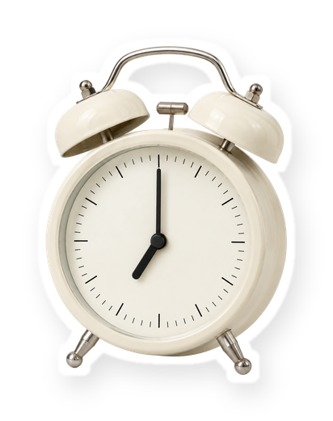
a day with my
[product]
morning
[7am]
Everything blue is a guide. Delete it before you download.
Notes:
Slide 1. Hook. Swap in a photo of your morning with it. Edit [product] and the time.

Slide 2

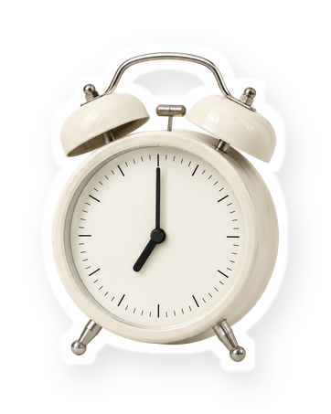
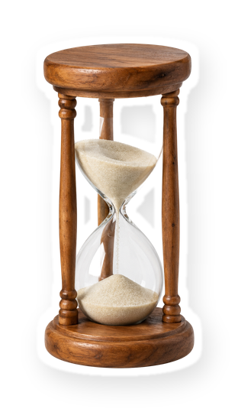


[what my day
really looks like]
[7am to 9pm]
Notes:
Slide 2. Second hook: Instagram often shows a carousel starting on slide 2, so this one works as a cover on its own. No photo needed. Edit both [bracket] lines.

Slide 3



midday
[12pm]
Notes:
Slide 3. Midday: swap in its photo. Edit the time.

Slide 4
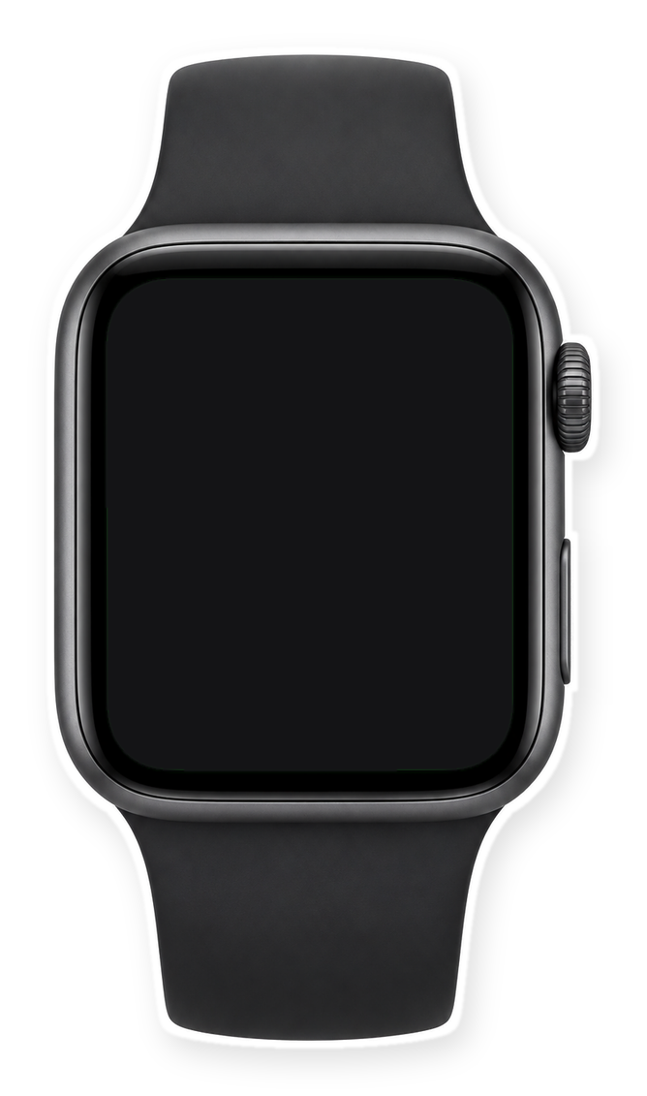

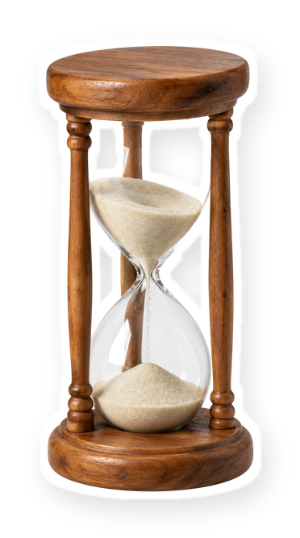
afternoon
[4pm]
Notes:
Slide 4. Afternoon: swap in a photo for the watch screen. Edit the time.

Slide 5







night
[9pm]
Notes:
Slide 5. Night: swap in its photo. Edit the time.

Slide 6


[my whole day]
[7am]
[12pm]
[4pm]
[9pm]
Notes:
Slide 6. The whole day: the same four photos. Edit the times.

Slide 7

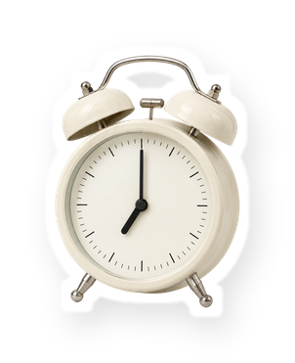


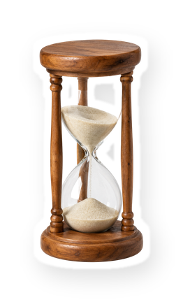

every day
[Product name] at [shop]
comment "[KEYWORD]"
Notes:
Slide 7. Swap in a photo of your product. Type its name, shop and keyword. Caption to start from (CTA in the first two sentences, 3 hashtags): Comment [KEYWORD] and I will send you [the link]. [One line of real context: who it helps or how you use it.] #[tag] #[tag] #[tag]

